Slide 1
CS 125
Hangman Project
By Cole Boehlert and Stanley Drapesa
A C program that takes words and checks with a file to make sure its the correct word.

Slide 2
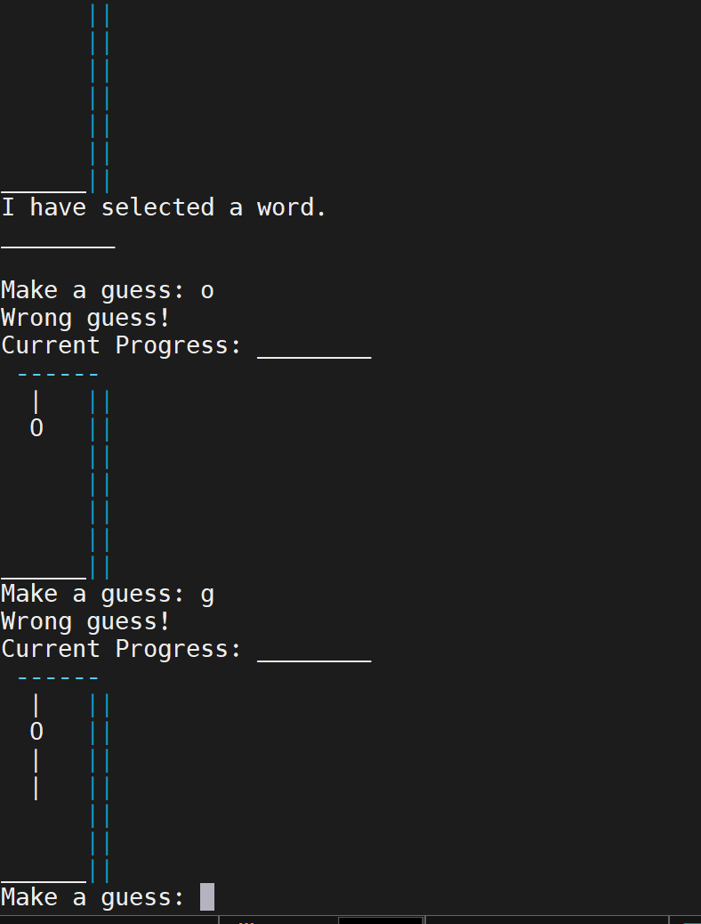
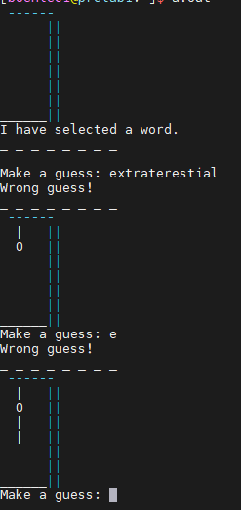
Problem statement
The program is a game of Hangman
Input: words or letters
Output: words and pictures
Example:

Slide 3
How it works
Selects word
Prints message and picture
User makes guess
Program checks guess with word and lets user know if it's right or wrong
Program shows picture to confirm if guess was right or wrong
Program repeats until win or lose

Slide 4
Data types
Char was the most used data type
Int was the second most used data type
We did use three pointers, those being *word_bank and *random_word, and *word

Slide 5
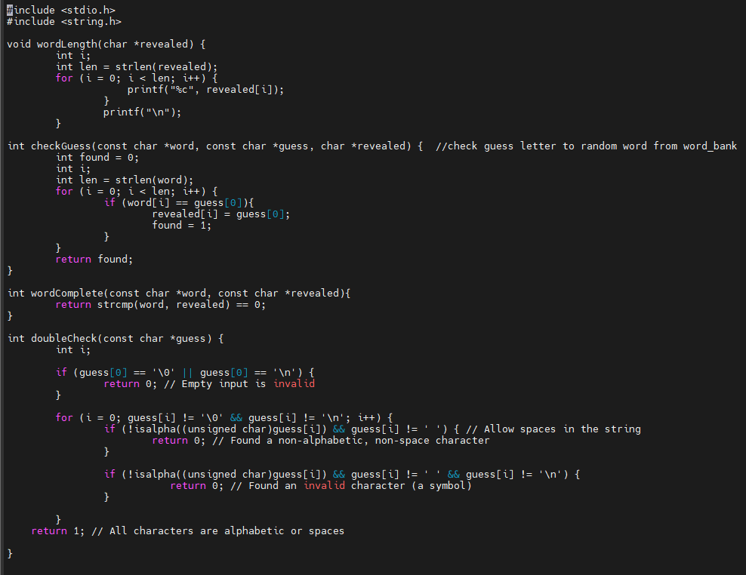
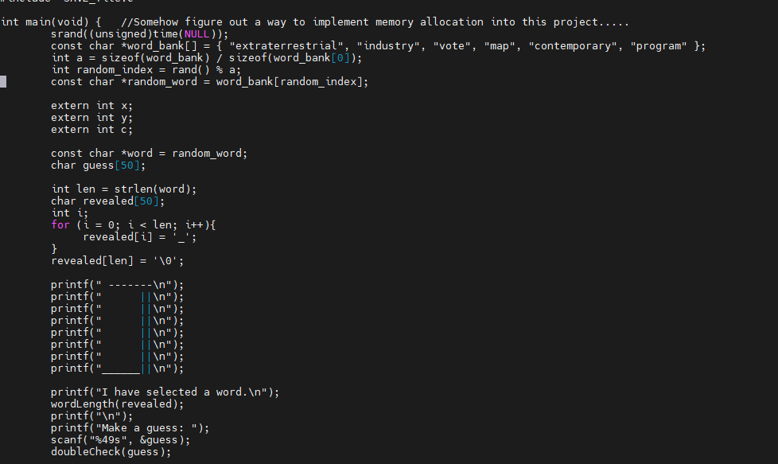
Key code structures
wordCheck.c
int main()

Slide 6
Takeaways
We had a lot of compiler problems and bugs in the code
It taught us to never give up and always keep trying new things, even if it might not be the answer

Slide 7
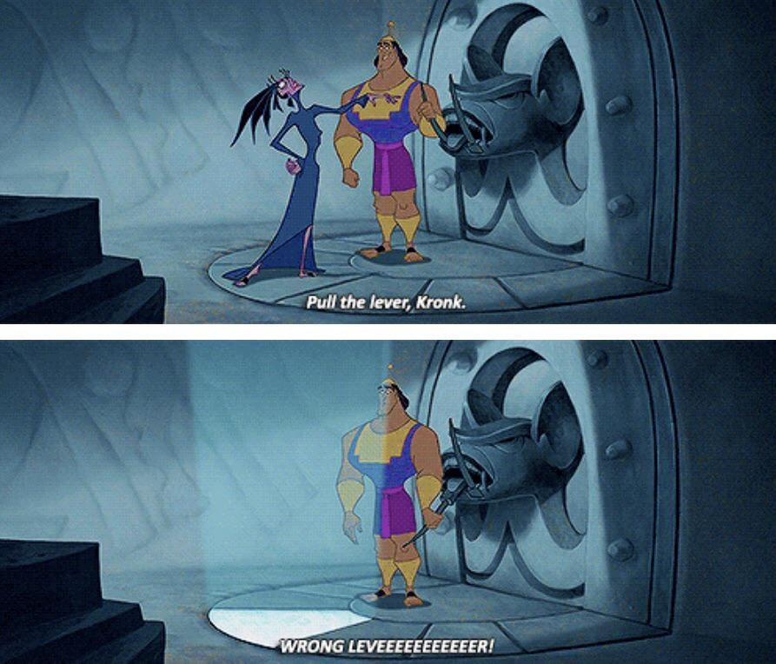
Run the code
codeeeeeeeeeeeee

